Slide 1
Integrated Learning Environment for ‘Programming with Functions’

Slide 2
User
Selected Language
C#
Function definition
Expression evaluation
int Square(int n) => n * n;
3+4
7
Square(3+4)
49
Submit
Clear
Task – 1372
Feedback
Define a function named Square which takes in an integer number and returns the square of that number.
For this task you may use any arithmetic operators, but no ready-made functions.
4 marks available
All tests for Square passed.
Request next hint (1 mark)
Submit completed task
Clear

Slide 3
Story 1 : Expression evaluation
Simple expression, returns result
Scrolling window
Entry may wrap onto multiple lines.
Can get back previous entries via cursor up
Cannot edit anything other than current entry
Clear button
Only functions/methods from approved list usable
Separate errors into the System Feedback, and maximise clarity:
Syntax/parsing error
Not an expression (e.g. an assignment statement)
Calling an unrecognised or unapproved function, or variable
Runtime error e.g. division by zero, out-of-range, incompatible type
Add pre-defined named data sets to list
Ensure lists are returned in the format in which they are defined
User-selectable option to display the type with the result
Cannot paste into window
Feedback is also scrolling window, with Clear button
Expression evaluation
a = 4
Clear
Feedback
‘a = 4’ is not an expression
Clear

Slide 4
Function definition
Story 2 : Function definition
Happy case
Ensure that successful function may be used in Expression Evaluation
Handle errors in System Feedback
Syntax error
Other compilation error
(as with expressions – use of disallowed function)
Not a function definition (e.g. a statement)
Runtime error
Option to enforce that body of function must be a single statement of the form Return [expression] or, for C#, expression syntax
Transparent handling of namespaces
Definition of multiple functions that may call each other
Cannot paste into the function definition pane
int Square(int n) => n * n;
Submit

Slide 5
Story 3: Tasks
Add Task pane containing HTML
Specifies functions/methods/variables that may be used in this task
Add ability to define and execute tests
Tests should be executed in defined order, designed for simplest case first
Feedback shows No. of tests passed and first failure only - with input values, expected result, actual result
Button to submit task available only when (hidden) tests all pass
Get hints, in defined order, each one reducing the marks available
Option to specify time before next hint becomes available
Task successfully completed message in Feedback, showing marks, time started, duration
Decide how a task is set up e.g. as standalone URL? (Can then link to next task in the success message?)
Example of levels of hints:
Hint 1 describes algorithm in words
Hint 2 specifies which functions/data you need to use.
Hint 3 is partial code with fill-in-the-blanks
Hint four is complete code, but shown as image that cannot be cut/pasted – must still be copied into function definition area to get the minimum mark
Task – 1372 – Marks available 4
Define a function named Square which takes in an integer number and returns the square of that number.
For this task you may use any arithmetic operators, but no ready-made functions.
Request next hint (-1 mark)
Submit completed task

Slide 6
User
Language
C#
Function definition
Application
int Square(int n) => n * n;
Submit
Story 4 : Context application
The function(s) defined by the user as part of the task, when completed, are used within an application that the user may interact with
Application might be console, or simple GUI
All application code is hidden, written in TypeScript, and common to all user languages
the user writes only the pure functions representing core domain logic
A series of tasks results in the development of the complete core functionality of an application e.g. a game/simulation
Each task uses only teacher-authored code in the background, to avoid compounding any subtle errors not trapped by tests

Slide 7
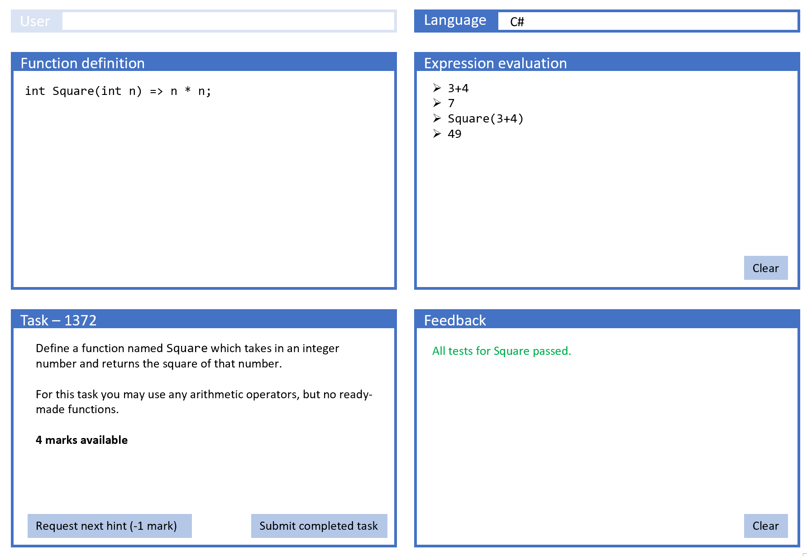
Client
Written in Angular
Combines some standard NOF views of Admin functionality with custom UI framework for programming tasks
TypeScript
Generic framework
Task-specific code, may include. example application (common to all user languages)
User-language specific (task generic) glue code
User language (Python, C#, VB.NET, Java, …)
User-entered expression
User-entered functions
(Hidden) wrapper-code, task specific but templated
Send: Programming language + user source code (with templated wrapper code)
Returns: Console output generated by successful execution, or compile / runtime errors
Given a task ID serves up whole page including all TypeScript files and (hidden) task-specific & generic wrapper code in user language.
Log-on
View assigned tasks
Record progress/marks
JOBE Server
(PHP on Linux)
Content-management system
One server
Administration system
(Naked Functions)
https://github.com/trampgeek/jobe#using-jobe
Need to add Mono templates for C# & VB.NET
Objects: Teacher, Student, Task, Assignment, …

Slide 8
Client: main code elements
Key:
TypeScript
User Language
Text or html
Separate version for each User Language
Separate version for each User Language
Written by framework developers
Generic client framework
Loads complete Task set-up
Wrapper code for expression and/or function definitions – to submit to JOBE
Glue code for invoking user-defined functions with arguments from Tests or Application
Each invocation is via JOBE, with functions and invocation as an expression
Parses the returned value into suitable TypeScript type
Test runner
Wrappers for expression and/or function definitions – to submit to JOBE
Interfaces for invoking user-defined functions with arguments
Each invocation is via JOBE, recompiling the functions and passing in the invocation as an expression
Parses the returned value into s
Hint and Marks management
Parsers for return messages from JOBE:
Extract/reformat/transform text elements
Post into Evaluator or Feedback panes
Set client states (control various buttons)
Parsers for return messages from JOBE:
Extract/reformat/transform text elements
P
Application runner
Written by task author
Task description
White list of usable functions
Applies to both expression and UDF panes
May be individual fully-qualified functions and/or complete namespace
User-defined functions will be wrapped transparently in a defined namespace (or static class), which is always in the whitelist
White list of usable functions
Applies to both expression and UDF panes
May be individual fully-qualified functions and/or complete namespace
User-defined functions will be wrapped transparently in a defined namespace (or static class), which is always in the whitelist
Hints (optional)
Tests (optional)
Hints
Starter code for Function definitions (optional)
Application code (optional)
Starter code for Function definitions (optional)
User-defined functions
Written by user
Expression

Slide 9
State management
Function definition pane knows:
whether or not current code has been submitted (to compiler)
if submitted, whether or not it has compiled successfully. (Might add a visual state indicator e.g. colour of code)
if compiled, whether or not any tests have all passed.
Upon successful compilation:
The functions may be used within expressions (before that any calls will be rejected by compiler)
if the Task defines any Tests (which are defined in TypeScript and independent of user language) then the Run Tests button appears (not sure whether in function pane or task pane). Run Tests disappears only if all tests have passed or if code has been edited
Upon successful test run:
if the Task defines an application, a Launch Application button will appear, which will launch the application code (which is written in TypeScript) and which will interface through calling routines to the user-defined functions.
Function definition
int Square(int
Submit
Run Tests
Launch application

